Slide 1
Huffman Code
Session 12
Henry Lucky, S.Kom. M.Kom.

Slide 2
Outline Materials
Session 12
Concept of compression technique
Introduction to Huffman code
Building Huffman tree
Creating Huffman Code table based on Huffman tree

Slide 3
Learning outcomes
LO 1: Explain fundamental concept of analysis algorithms
LO 2: Apply algorithm techniques and methods
LO 3: Solve a problem using specific algorithm.
LO 4: Compare several algorithm design methods

Slide 4
Concept of compression technique
How does a compression program really work?
Why can size of file be reduced without reducing its contain?
Supposed we will store letter A. Computer recognizes the letter as a character with sequence 65, then the letter is stored in harddisk as 1000001 (binary number of 65 decimal). It needs 7 binary digit to store letter A.
So, 1000001 is the codeword of A.
Data compression tries to store as minimum as possible number of binary digits.

Slide 5
Concept of compression technique
Encoding character
ASCII (American Standard Code for Information Interchange)
ASCII character encoding consists 128 characters; 7 bit binary numbers; printed 95 characters and 33 command character.
ISO 8859-1 is a standard character with 8 bit, can store 256 characters.
This standar is called as character encoding Latin-1.
UTF-8 (Unicode Transformation Format) is a standard encoding character that enable many languages as shown in the same time. Number of bit to store a character is different.
ASCII character is stored in 1 byte (8 bit).
Latin, Greek, Cyrillic, Armenian, Hebrew, Arabic, Syriac dan Thaana character is stored in 2 byte (16 bit).
Other languages character is stored in 3 byte (24 bit). Character of Jawa/Bali (hanacaraka alphabetic) dan Bugis from Indonesia exist in this standard.
In the future it is possible to store character in 4 byte.

Slide 6
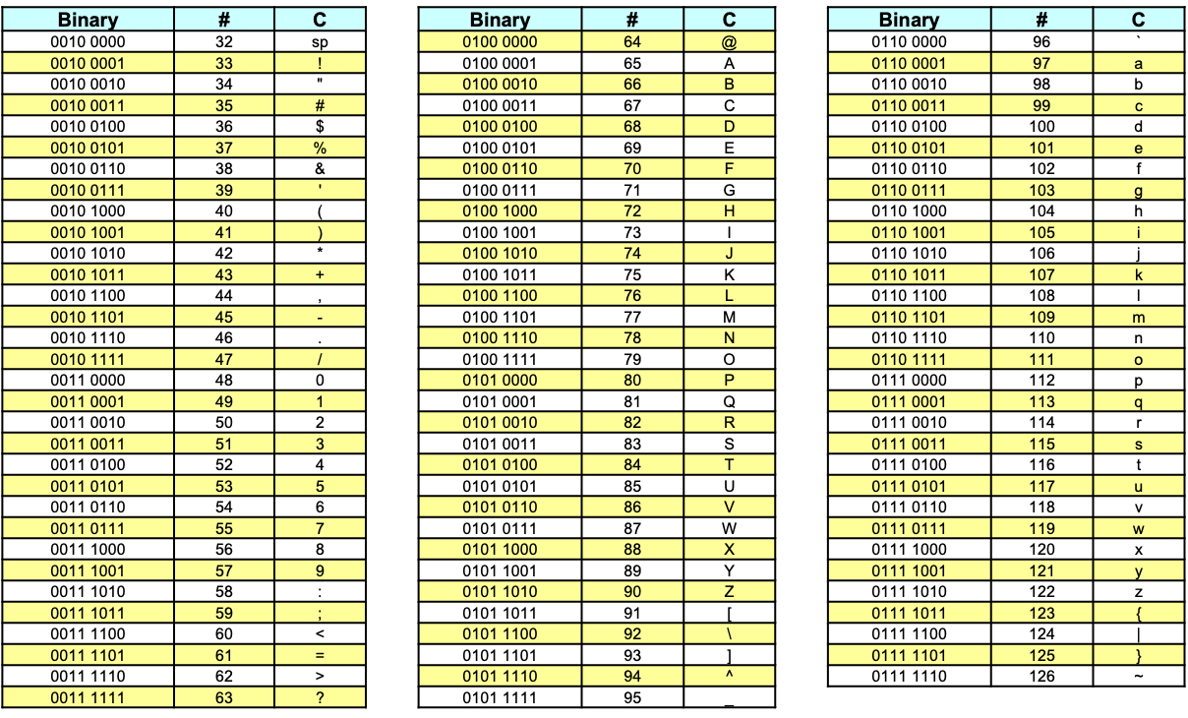
Concept of compression technique
Character table

Slide 7
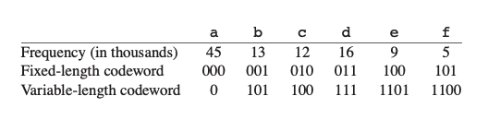
Concept of compression technique
Fixed length code vs variable length code
There are two types of codeword: Fixed-length and Variable-length.
For example, we have a data file of 100,000 characters contains only the character a-f
Fixed-length code requires (3 . 100,000) = 300,000 bits to encode the entire file.
Variable-length code requires (45 . 1 + 13 . 3 + 12 . 3 + 16 . 3 + 9 . 4 + 5 . 4) . 1,000 = 224,000 bits, a saving of ((300,000-224,000)/300,000 . 100%) = 25.33%.

Slide 8
Introduction to Huffman code
Huffman algorithm
Invented by David A. Huffman in 1951 when he studied his Ph.D at Massachusetts Institute of Technology (MIT).
He discovered a method to build binary tree based on frequency. The Binary Tree is called as Huffman Tree is foundation of data compression with ZIP format.
The technique is used as algorithm to create JPEG image and musical file format MP3.

Slide 9
Introduction to Huffman code
Prefix-free codes
E | 0
T | 11
N | 100
I | 1010
S | 1011
E | 0
T | 10
N | 100
I | 0111
S | 1010
11010010010101011
100100101010
Try to decode the code above using each table

Slide 10
Introduction to Huffman code
Prefix-free codes
No prefix of a codeword in a codeword -> prefix-free codes.
Uniquely decodable.
a prefix-free code can always achieve the optimal data compression among any character code,
so we suffer no loss of generality by restricting our attention to prefix-free codes.
Using variable-length codeword in slide 6, we have string 100011001101 which parses uniquely as 100 . 0 . 1100 . 1101, which decodes to cafe

Slide 11
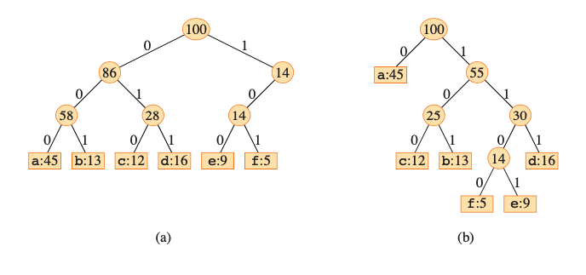
Introduction to Huffman code
Prefix-free codes
Note that optimal code for a file is always represented by a full binary tree!
(a) is tree corresponding to the fixed-length code
(b) is tree corresponding to the optimal prefix-free code.

Slide 12

Creating a Huffman tree
Computing cost
Given a tree T corresponding to a prefix-free code, we can compute the number of bits required to encode a file.
For each character in c the alphabet C, let the attribute c.freq denote the frequency of in the file and let dT(c) denote the depth of c’s leaf in the tree.
Note that dT(c) is also the length of the codeword for character c.
The number of bits required to encode a file is thus
$$B\left(T\right)= \sum_{c∈C}{c.freq∙d_{T}(c)}$$
Which we define as the cost of the tree.

Slide 13
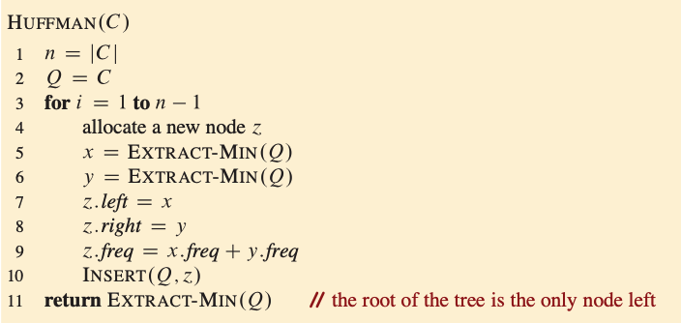
Creating a Huffman tree
Huffman procedure

Slide 14
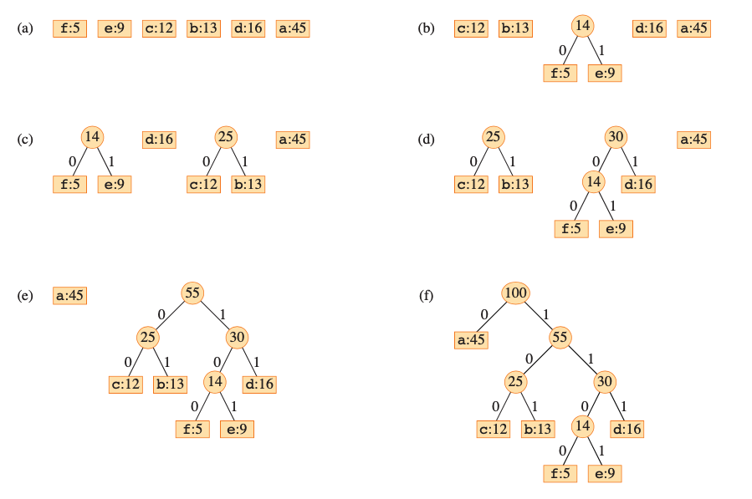
Creating a Huffman tree
Huffman procedure: Example

Slide 15
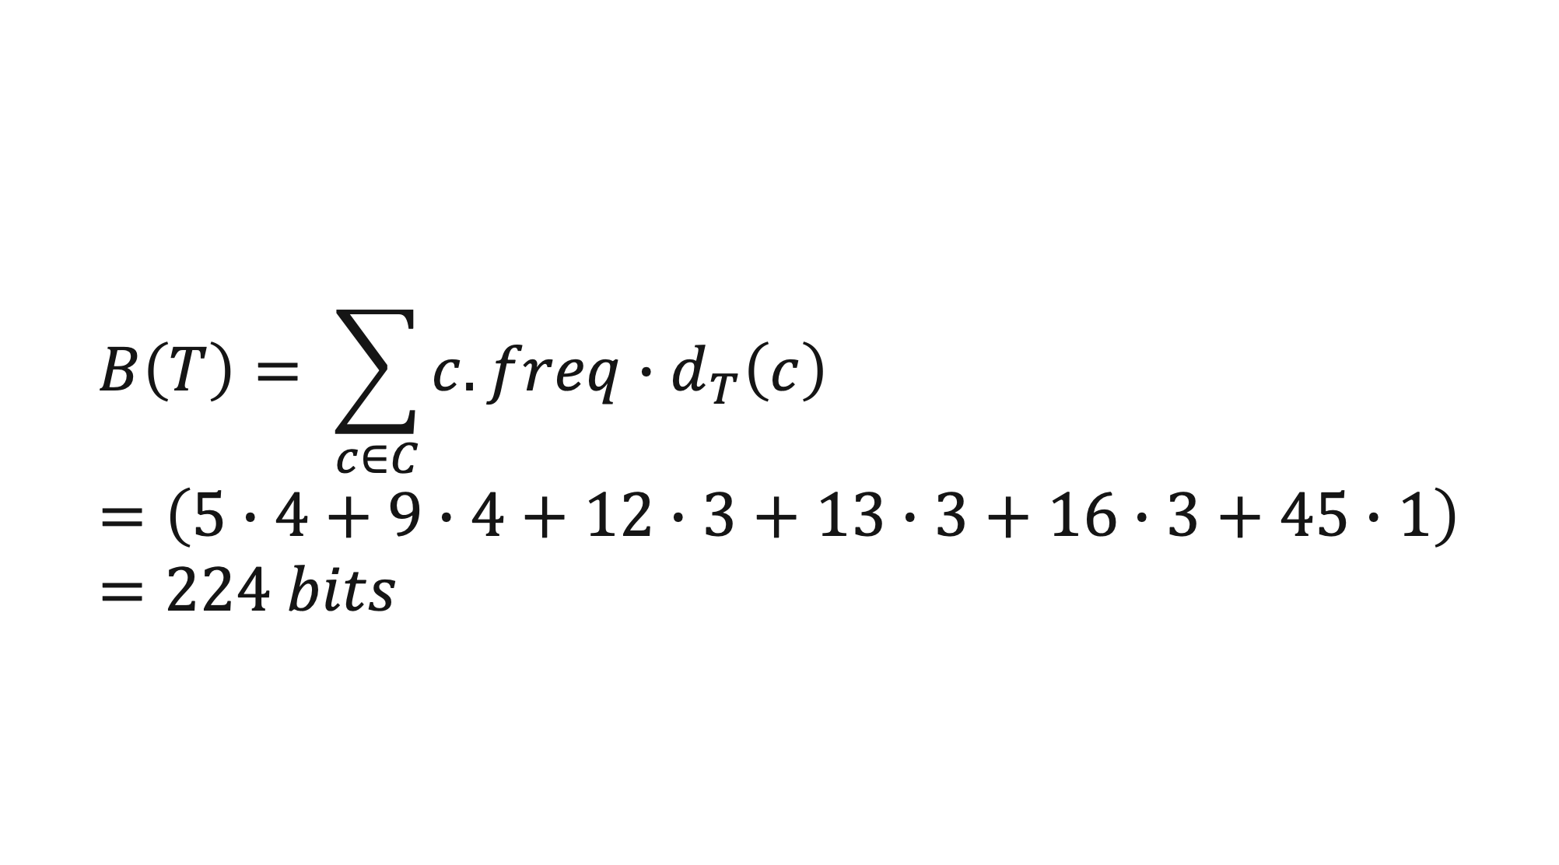
Creating Huffman Code table based on Huffman tree
f | e | c | b | d | a
5 | 9 | 12 | 13 | 16 | 45
← Frequency table
f | e | c | b | d | a
1100 | 1101 | 100 | 101 | 111 | 0
← Huffman code table
$$B\left(T\right)= \sum_{c∈C}{c.freq∙d_{T}\left(c\right)}=\left(5∙4+9∙4+12∙3+13∙3+16∙3+45∙1\right)=224 bits$$

Slide 16
Creating Huffman Code table based on Huffman tree
Analysis
The running time of Huffman’s algorithm depends on how the min-priority queue Q is implemented.
Let’s assume that it’s implemented as a binary min-heap.
For a set C of n characters, the the heap initializes in O(n) time in line 2.
The for loop in lines 3-10 executes exactly n-1 times, and each heap operation runs in O(lg n) time.
Thus, the loop contributes O(n lg n) to the running time.
The total running time is then O(n lg n).

Slide 17
Exercises
12
Create Huffman code to compress:
DESIGN AND ANALYSIS OF ALGORITHMS
Calculate the bits above and compare it with the traditional fixed-length codes. (Calculate the % savings)
For uniform character distribution, the Huffman encoding will be equal to the fixed-length encoding. Why?

Slide 18
References
Thomas H. Cormen. (2022). Introduction to algorithms: Fourth edition. The MIT Press. Chapter 15.
https://u.cs.biu.ac.il/~amiram/greedy_algorithms_huffman.ppt

Slide 19
Thank you
Huffman Code
September, 2023

